Slide 1
THE COMPANIES ACT, 2013
(Important Provisions)
Presented By:
CS Dhanraj Singh Thakur
Practising Company Secretary & Designated Partner
Athena Business Advisors (India) LLP

Slide 2

WHAT IS A COMPANY???
A company is an association or collection of individuals,
whether natural persons, legal persons, or a mixture of both.

Slide 3

BACKGROUND OF THE ACT
The Companies Act 2013 is an Act of the
Parliament of India
which regulates incorporation of a company, responsibilities of a company, directors, dissolution of a company.

Slide 4
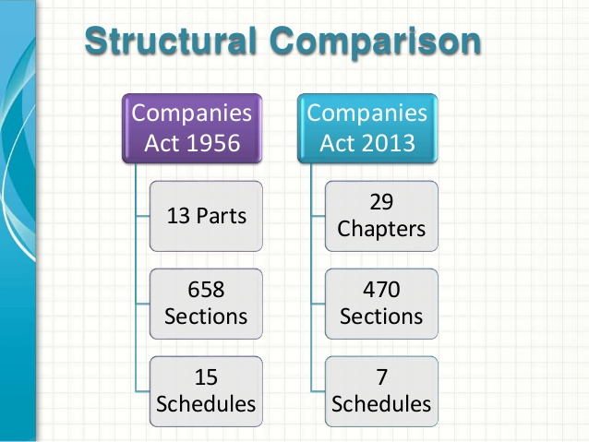

Slide 5
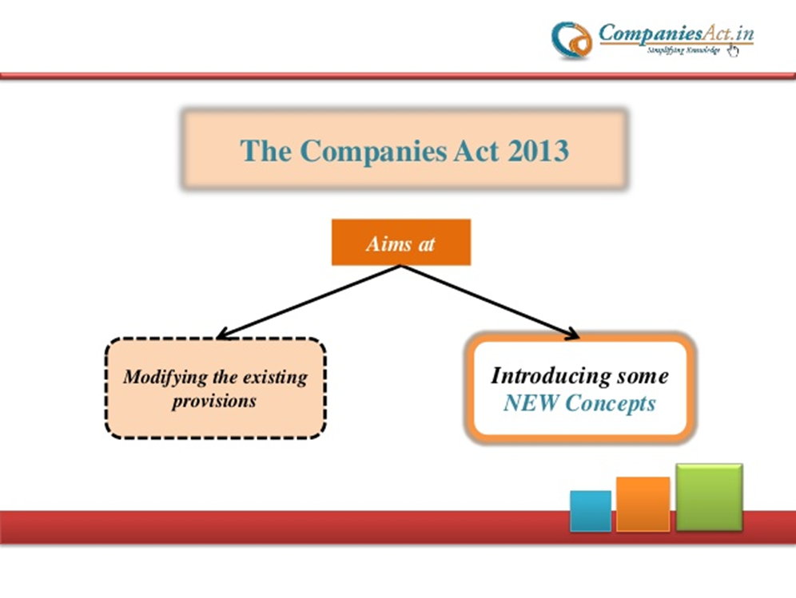

Slide 6
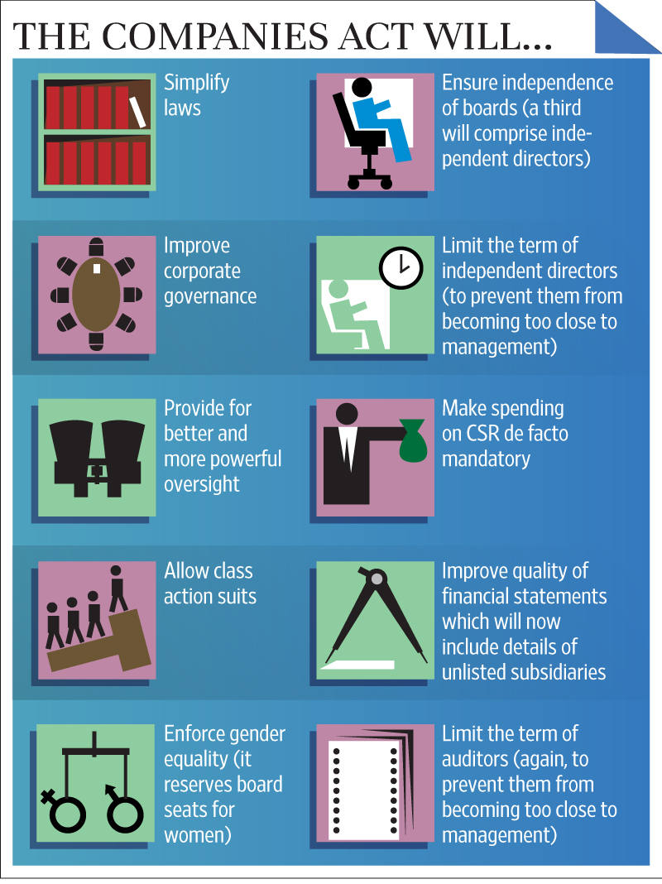

Slide 7
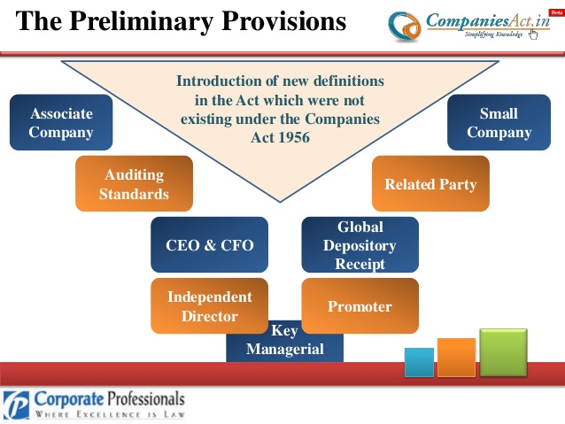
PRELIMINARY PROVISIONS

Slide 8

TYPES OF COMPANIES
By Liability
Private Limited
Public Limited
By Listing
Unlisted
By Constitution
Listed
Section 8
One Person Company
Limited Liability
Unlimited Liability

Slide 9
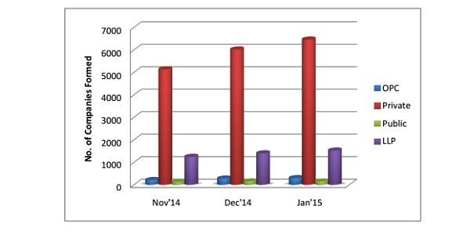

Slide 10
DIRECTORS
As a Trustee- In relation to the company
As Agents- When they act on behalf of the company
As Managing Partner- As they are entrusted with the
responsibility of the company
The Director of a Company occupies the position:
If acts are done by the director prior to he or she being disqualified, the acts are considered to be valid.

Slide 11
Section 149- Company to have Board of Directors
Section 150- Manner of Selection of Independent directors and maintenance of databank of independent directors
Section 152- Appointment of Directors
Section 153- Application for allotment of DIN
Section 155- Prohibition to obtain more than one DIN
Section 161- Appointment of additional, alternate and nominee director
Section 164- Disqualification for appointment of directors
Section 165- Number of Directorships
RELEVANT SECTIONS PURSUANT TO DIRECTORS

Slide 12
Duties of Directors
FIDUCIARY DUTIES
To act honestly and with good faith.
Not to use confidential information of the company for their own purpose.
STATUTORY DUTIES
Not to contract with company, where he/she or his relative has an interest in the contract where he/she has a interest, they need to inform the board or seek prior approval while entering into contract, otherwise the contract is voidable.
Duty to attend and Duty not to delegate.
Duty of Care and to act reasonably while acting for the company.

Slide 13
Duties of Directors
Statutory Returns can only be filed with ROC in time when they are prepared in time.
The Board should ensure that accounts are audited in time and AGM has been held in time.
A Director of a Company shall not assign his office and any assignment so made shall be void.

Slide 14
Liabilities of Directors
-The liability of the Directors can be either civil or criminal.
-Liability may be for breach of fiduciary duties
-The directors are personally liable for the following:
a) Ultra vires acts
b) Malafide acts
c) Negligent acts
d) Liability for the acts of third parties

Slide 15
DIN denotes Director Identification Number
It is an unique Identification Number allotted to an individual who is an existing Director of a company or intends to be appointed as Director of a company pursuant to Section 153 & 154 of the Companies Act, 2013.
Every person who is required to be appointed as Director of any company is required to have a DIN & DSC.
DIN AND DIGITAL SIGNATURE(DSC)

Slide 16
- All filings done by the companies under MCA21 e-Governance programme are required to be filed with the use of Digital Signatures by the person authorized to sign the documents such as Director etc.
- DIN can be obtained by filing the form with DIN Cell with PAN No. and Address proof along with passport size photograph.
- By DIN, a person can easily be identified in how much companies, he is a director and in which capacity all over the country including Public, Private or otherwise.
DIN AND DIGITAL SIGNATURE(DSC)

Slide 17
How to assess information of Directors through MCA Portal

Slide 18
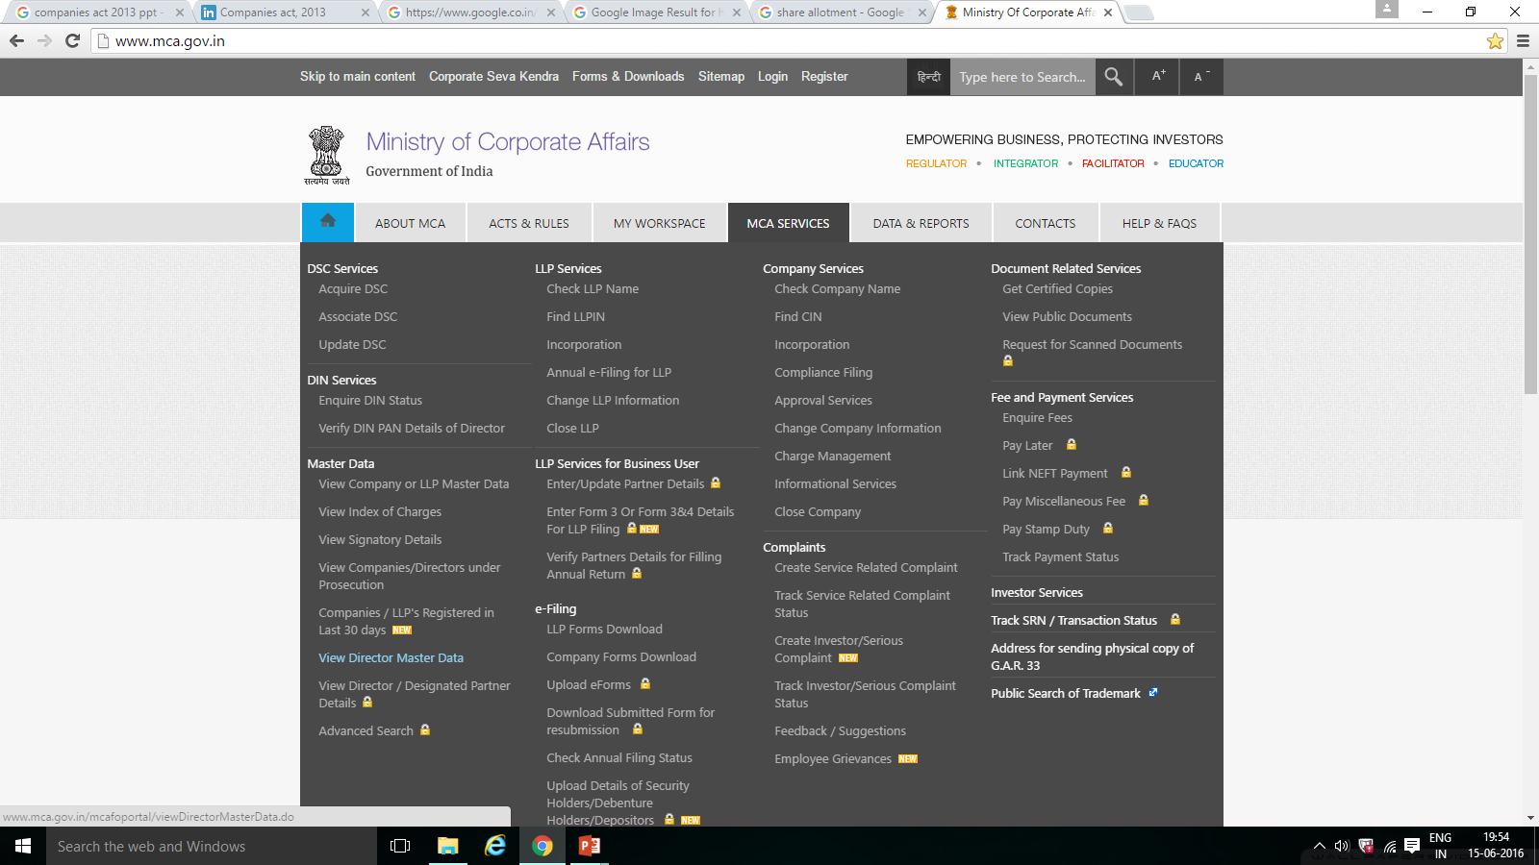

Slide 19
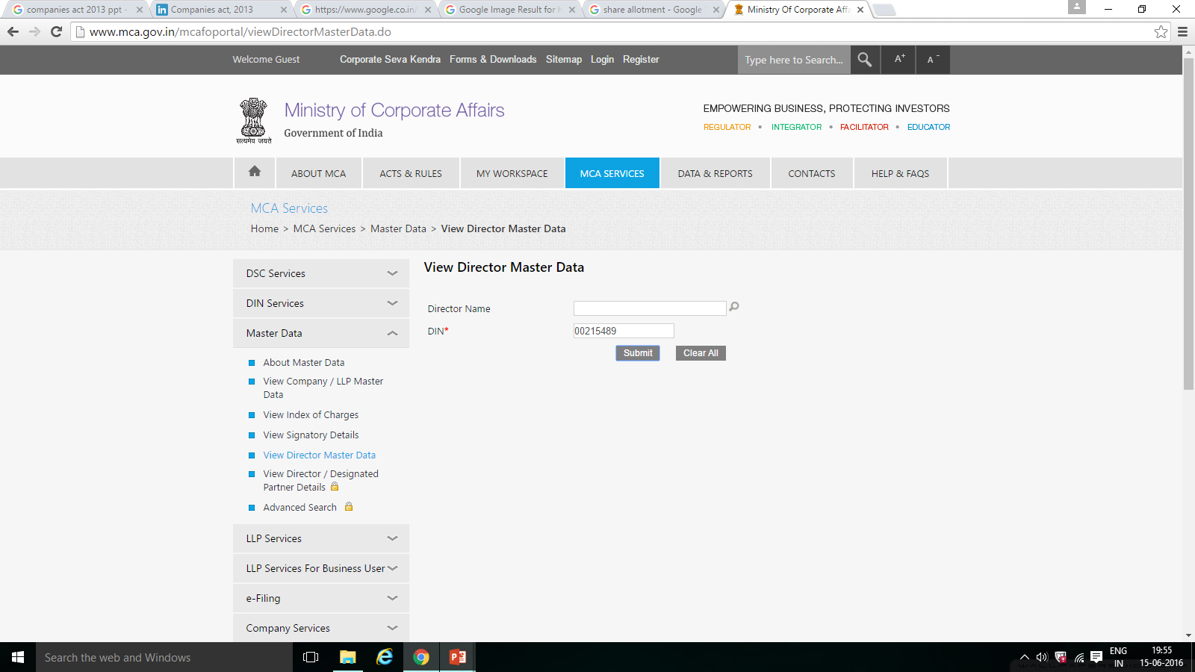

Slide 20
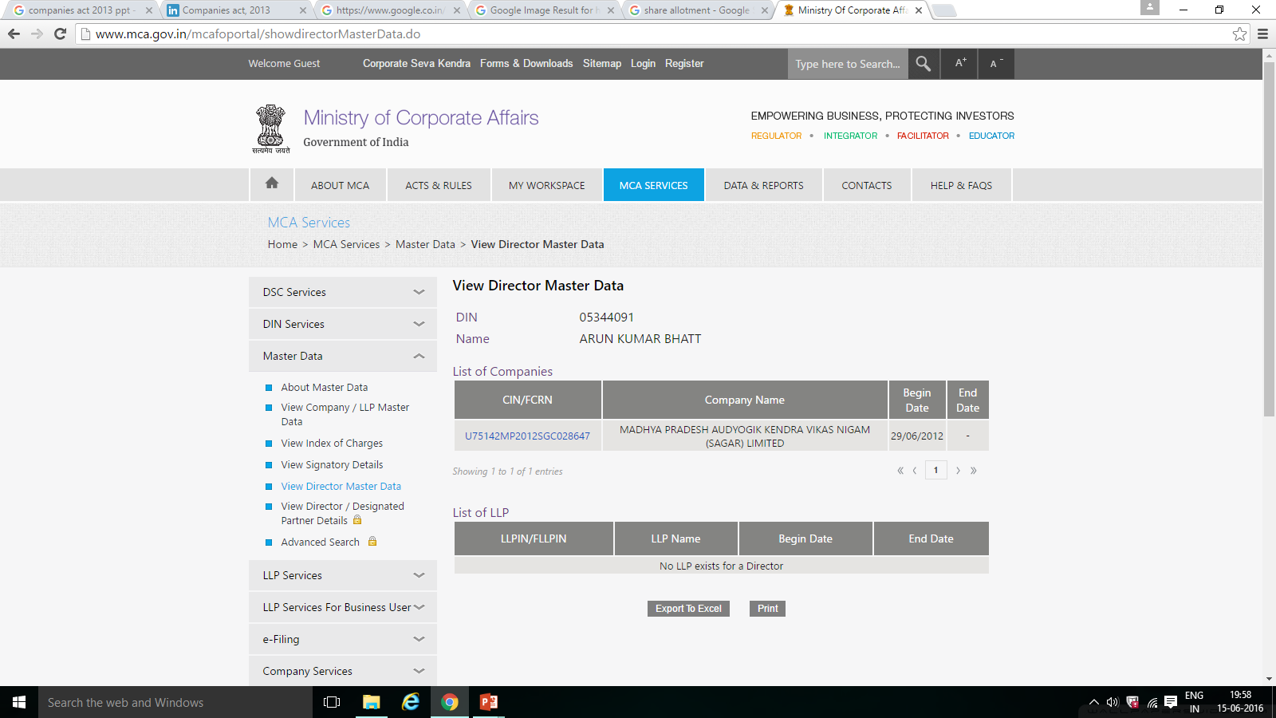

Slide 21

SHARE: Share is a small unit of share capital of the company. It is “an interest having a money value and made up of diverse rights specified under the articles of association”.
SHARE CAPITAL: Share capital means the capital raised by the company by issue of shares.
Share gives a right to participate in the profits of the company, or a share in the assets when the company is going to be wound up.
SHARE CAPITAL

Slide 22
KINDS OF SHARE CAPITAL
*Preference shares
*Redeemable Shares
*Irredeemable Shares
*Equity or ordinary shares
*Shares at premium
*Shares at discount
*Bonus shares

Slide 23
SOURCES OF RAISING CAPITAL
SOURCES
OWNED FUNDS
BORROWED FUNDS

Slide 24
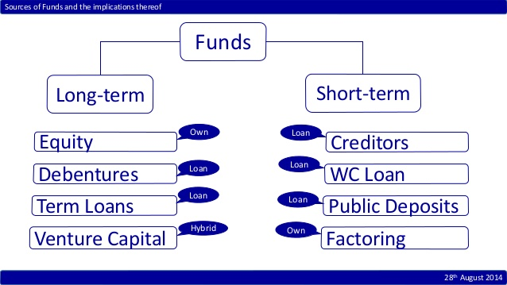

Slide 25
ALLOTMENT OF SECURITIES BY COMPANY
As per section 42(6) of Companies Act, 2013,
if Company has received any amount received for the purpose of allotment of shares on Private placement basis then shares must be allotted within 60 days of receiving share application money
otherwise Company shall refund the whole application money within 15 days from the completion of 60 days.
If it fails to repay within the above prescribed period, it shall be liable to repay the amount with interest at the rate of 12% p.a. from the expiry of sixtieth day.
Money received under this section shall be kept in a separate bank account, i.e., Escrow Account.

Slide 26
STATUTORY REQUIREMENTS OF APPOINTMENT OF A COMPANY SECRETARY
Every listed company and every other company having paid-up share capital of Rs. 5 Cr or more to appoint the Company Secretary in whole-time employment.
Company Secretary is a Statutory Post under the Companies Act, 2013.
He has to report to the Board about the compliance of the provisions, rules and other laws applicable to the company. He has to make sure that company complies with the secretarial standards and other relevant law and rules.

Slide 27
THANK YOU ☺
CS Dhanraj Singh Thakur FCS, M. Com. (P), L.L.B. | Designated Partner Athena Business Advisors (India) LLP 147, II Floor, Zone-2, M.P. Nagar, Bhopal-11 +91-9074660044

